Slide 1
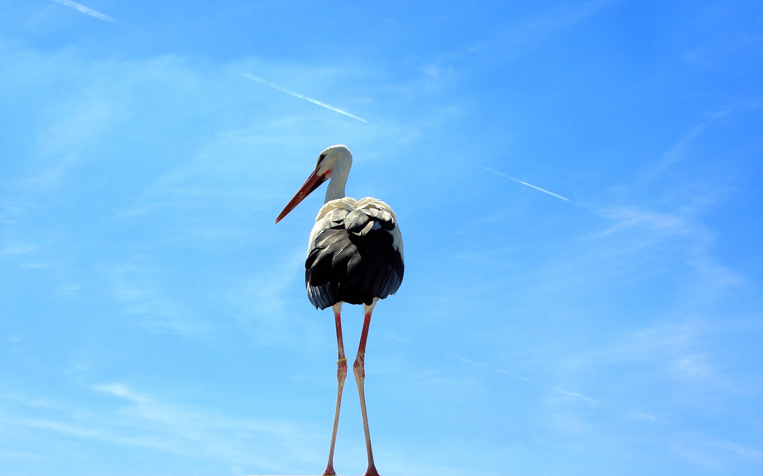
COMMUNICATING SCIENCE
BQ5 Creativity Lesson 10
I can explain how new forms of communication are affecting the integrity of science
Notes:
See how this lesson links to the course by viewing the final slide
Key TOK terms appear in a red font

Slide 2
Starter
What are the pros and cons of using social media to communicate and explain knowledge?
Notes:
In some ways, it’s great, as it can get across ideas to a wide audience, and do so quickly.
However, its medium is not one that encourages detailed in-depth explanations; it may also create problems in terms of speed of delivery - hypotheses need to go through peer review, replication, etc. in order to be properly established.
Getting across unverified ideas can end up harming the integrity of our knowledge.
Note the image - the concept of being ‘liked’ for our comments; we’re often motivated to give people what they want to hear, rather than present the truth about the world.

Slide 3
Pair, share
Do you think that modern forms of communication (as we saw in this BQ’s earlier classes) help or hinder the communication of scientific ideas? Explain your answer.
Notes:
Build on what the students came up with for the last question. What we said there applies even more to scientific knowledge, which needs to be communicated with more accuracy, and more depth, than other areas of knowledge, and where it’s easy to completely misrepresent what is being communicated by abridging ideas and concepts (see Molly Crockett’s TED talk which we looked at in BQ3).
It’s worth being clear about the LO of this lesson - science faces a big problem at the moment. We are increasingly communicating via social media, but scientific knowledge is very hard to communicate using these means.

Slide 4
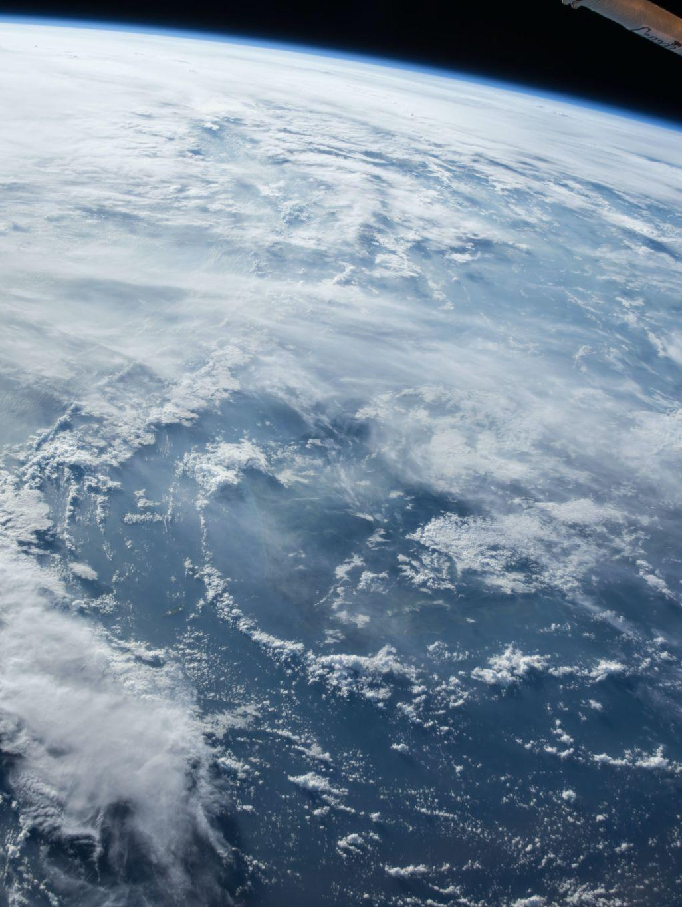
N.dG.T. vs B.o.B.
Watch the video about the Twitter spat between Neil deGrasse Tyson and B.o.B.
Why is a discredited idea now being listened to by thousands of people? Write down a possible hypothesis to explain what’s going on.
Notes:
This obviously suggests that social media can foment discredited ideas, such as the earth being flat.
Anyone can offer their theories about the natural world, without possessing any expertise about the natural world.
However, note we’ll consider the flat-earth belief in a more nuanced way in our next unit...

Slide 5
The challenge for science
In pairs, create a presentation to explain the problem that science currently faces in terms of getting its ideas across in the social media age.
Follow the instructions in the handout to carry out this task.
Use the Vox and The Conversation articles as the foundation for your presentation. If you find further sources - great!
Notes:
From The Conversation article (How social media can distort and misinform when communicating science)
The media creates “a misinformation cycle”
Clickbait and sensationalism lead to “scienceploitation”
There is a lack of civility in online and social media forums
Researchers and scientists often display a “disconnected arrogance”
From the Vox article (What journalists get wrong about social science, according to 20 scientists)
Science rarely provides “clear answers to life and social problems”
Scientific studies are often very narrow
An obsession with ‘newness’
Statistics are often problematic
Translating technical terms
Correlation and causation (see BQ3)
Overall - Is social media causing people’s understanding of science to diminish? Is there a solution? Is this a more general problem, affecting knowledge in general - or is science the area of knowledge most affected by the communication revolution that’s going on? Are there any upsides to using social media to communicate scientific knowledge?
How has the Covid-19 pandemic affected (worsened/improved) all this?

Slide 6
Links to the TOK exhibition
Related exhibition prompt What challenges are raised by the dissemination and/or communication of knowledge? (IAP-10)
Refer to the ideas from this lesson to answer this question.
For example, think about the difficulties in communicating scientific ideas clearly and accurately - particularly via digital means.
Which objects could help to illustrate your answer?
Notes:
Optional slide, if you want to help students to take ownership of the IA prompts (IAPs) for the TOK exhibition

Slide 7
Does the fact that communication is now much easier undermine the integrity of scientific knowledge?
Explain your answer.
Notes:
See the BQ5 assessment tracker for suggestions on providing feedback, and recording students’ progress.

Slide 8
Linking this lesson to the course
During this lesson, we consider the highlighted aspects of the TOK course
The images used in the presentation slides can also give students ideas about selecting exhibition objects; see also our link below to specific IA prompts
CORE THEME | OPTIONAL THEMES | AREAS OF KNOWLEDGE | TOK ASSESSMENT
Knowledge & the knower | Indigenous societies | The arts | The TOK essay
 | Language | History
 | Politics | The human sciences | The TOK exhibition Could be linked to IAP-10 (communication), IAP-22 (experts), IAP-24 (context).
 | Religion | Mathematics
 | Technology | The natural sciences

Slide 9
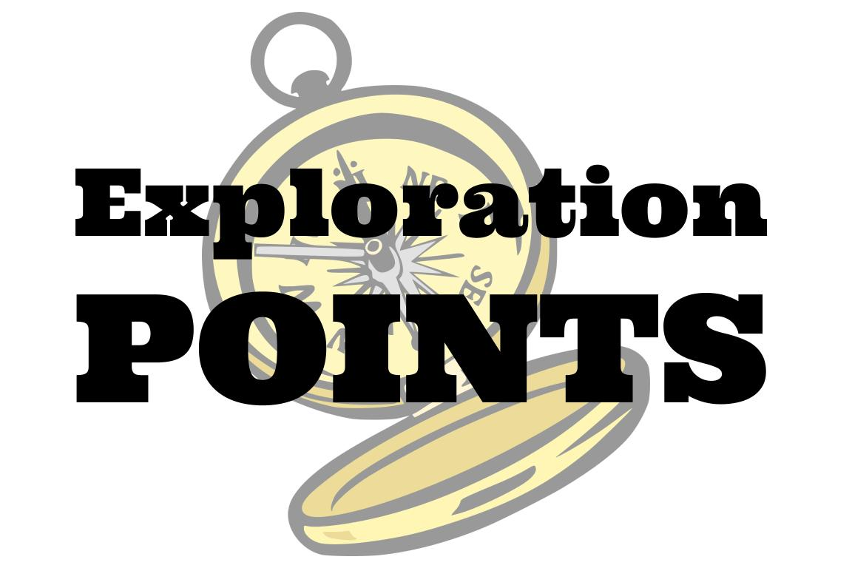
Explore the TOK themes and areas of knowledge in more depth via a range of thinkers, media sources, and other resources, in our EXPLORATION POINTS DOCUMENTS.
Access the documents via the links below. You’ll also find the EP icons on all of the TOK course pages of the site to help you unpack the quotes, KQs, and real-life situations that you find there.
CORE THEME
Knowledge & the knower
OPTIONAL THEMES
Indigenous societies
Language
Politics
Religion
Technology
AREAS OF KNOWLEDGE
The arts
History
Human sciences
Mathematics
Natural sciences
Notes:
Use this slide to access the ‘Exploration Points’ notes for BQ5, which will help students to develop a deeper knowledge of any TOK theme or area of knowledge. This will not only help them to master the TOK course in general, but also craft a great exhibition or essay.
Be ready to provide more guidance on how to use this resource - ie, which media sources to focus on, which questions to address, which TED talks to watch, and which key terms and ideas to understand.

